Slide 1

Bhoo - Mithra - Sena
C.H.M.K.M GOVERNMENT ARTS AND SCIENCE COLLEGE,TANUR
C.H.M.K.M GOVERNMENT ARTS AND SCIENCE COLLEGE,TANUR,K.PURAM.P.O,MALAPPURAM,KERALA,676307,PH:0494 2582800

Slide 2

Table of Content
  About us
  Faculties in Charge
  Activities
C.H.M.K.M GOVERNMENT ARTS AND SCIENCE COLLEGE,TANUR,K.PURAM.P.O,MALAPPURAM,KERALA,676307,PH:0494 2582800

Slide 3
About Us
Bhoo Mithra Sena Club is sponsored by the Directorate of Environment and Climate Change, Govt. of Kerala, for strengthening the commitment of students at the college level in the Kerala State. Addressing environmental issues is a multidisciplinary task and for its objective accomplishment , strong action on awareness building is essential.Boo Mithra Sena Club Activities started on January 2022 at Government Arts and Science College Tanur.
Objectives
To encourage the students to appreciate the environment and environmental issues of the locality
To provide environmental education opportunities for students and involve them in addressing
environmental issues of the locality
To utilize the enormous manpower available with students as conduits for awareness of the
society
To make students practice and advocate sustainable lifestyles
To improve the overall environmental quality of the institution.
C.H.M.K.M GOVERNMENT ARTS AND SCIENCE COLLEGE,TANUR,K.PURAM.P.O,MALAPPURAM,KERALA,676307,PH:0494 2582800

Slide 4
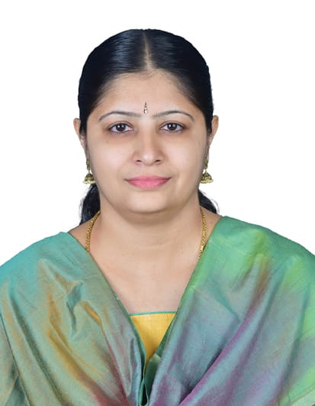
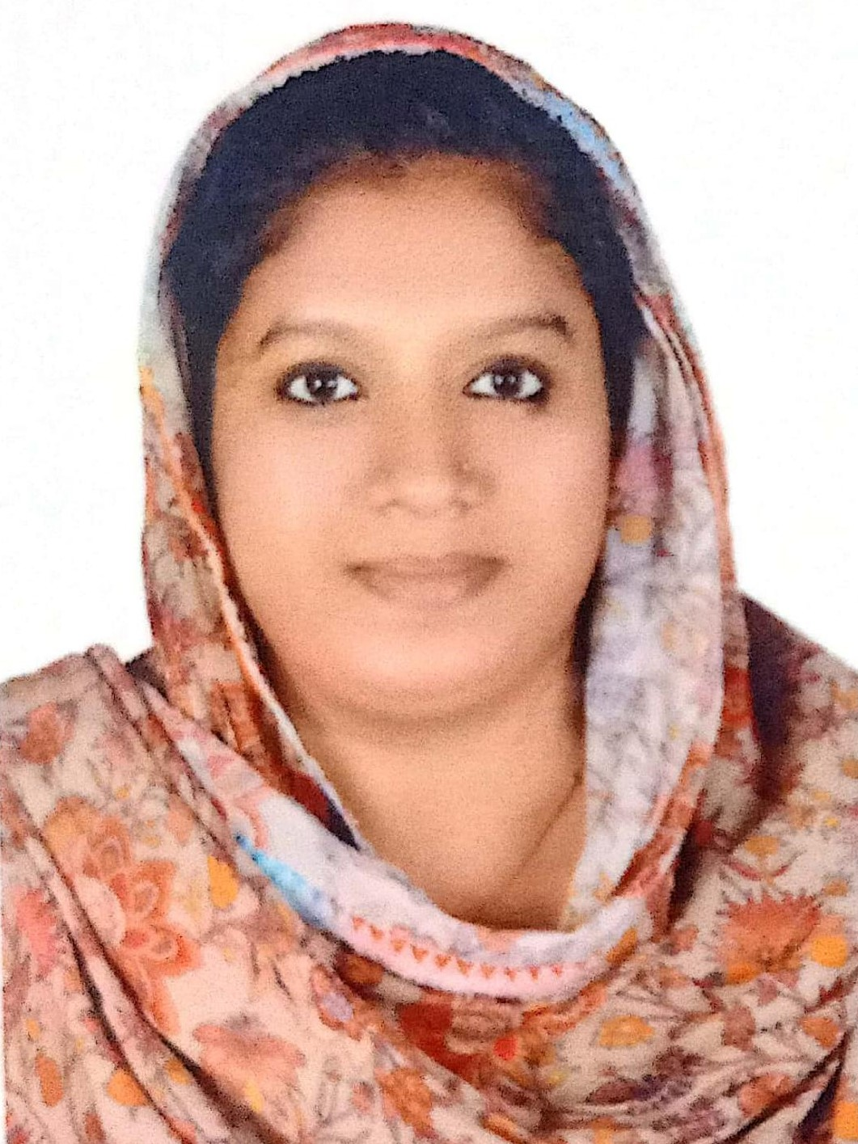
Name: NISHA.C.M
Designation:
Assistant Professor in Computer Application
Faculties in charge
Name: JASNA O
Designation: Assistant Professor in Management(on Contract )
C.H.M.K.M GOVERNMENT ARTS AND SCIENCE COLLEGE,TANUR,K.PURAM.P.O,MALAPPURAM,KERALA,676307,PH:0494 2582800

Slide 5

Club Inauguration
Picture
Bhoo-Mithra- Sena Club Inauguration was done by Dr.Ashkarali P Principal in charge on January 31st 2022 at Pluto hall at 10 am.
C.H.M.K.M GOVERNMENT ARTS AND SCIENCE COLLEGE,TANUR,K.PURAM.P.O,MALAPPURAM,KERALA,676307,PH:0494 2582800

Slide 6
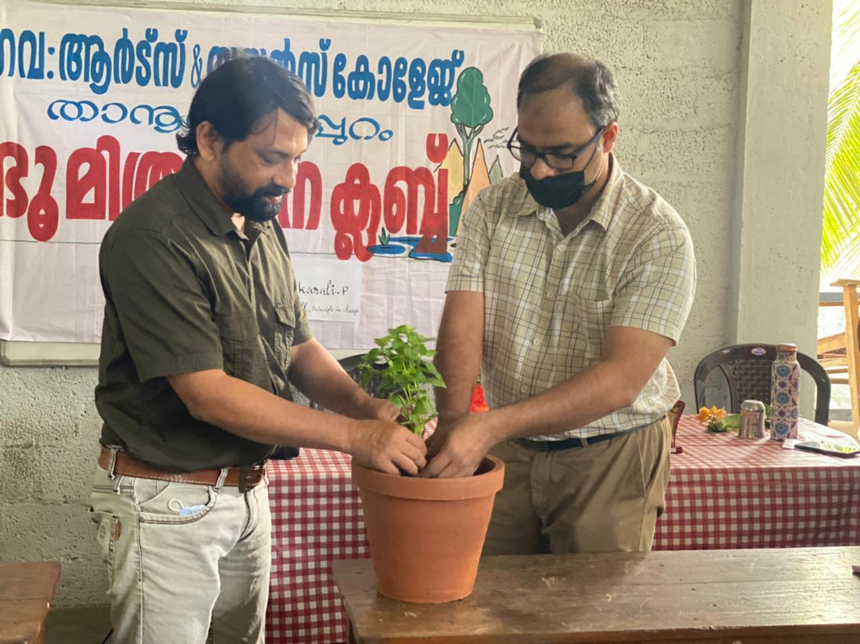
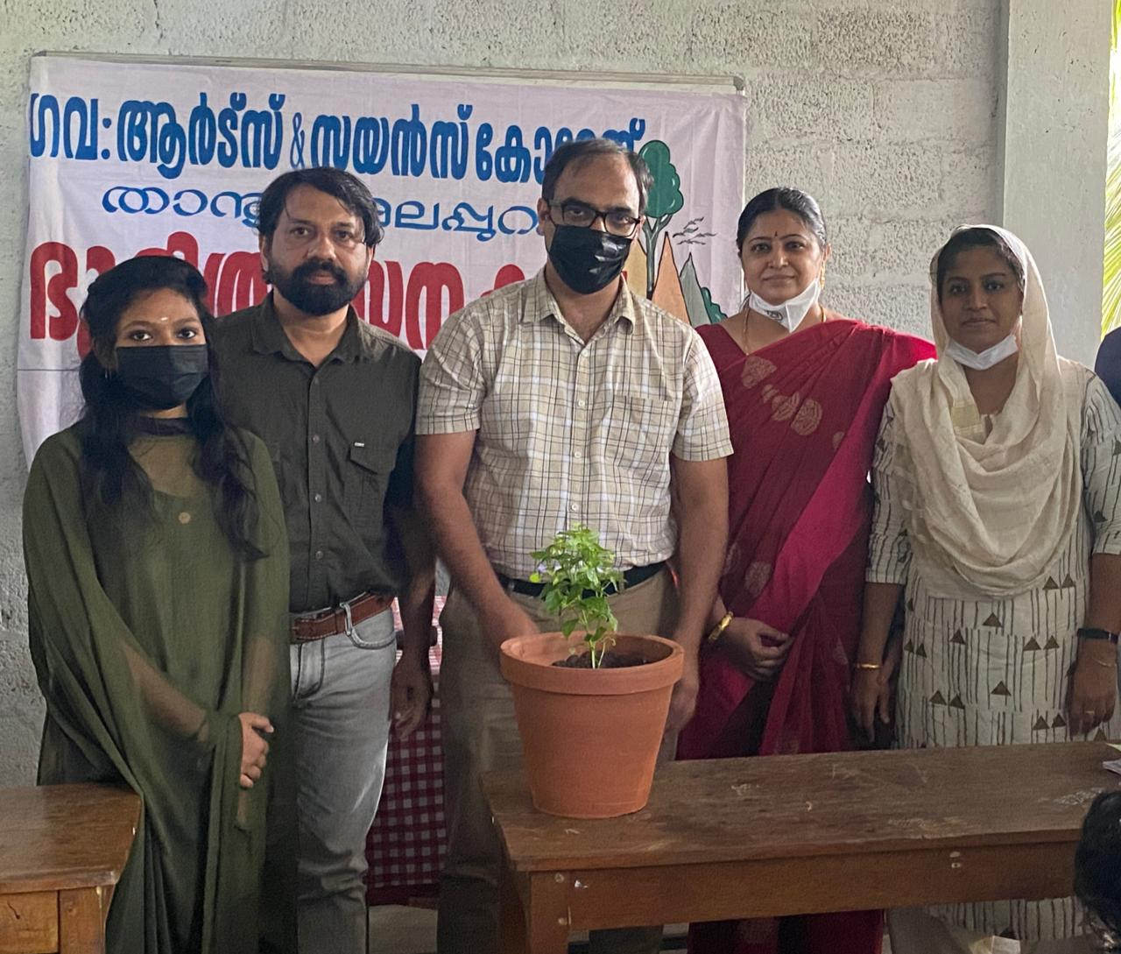
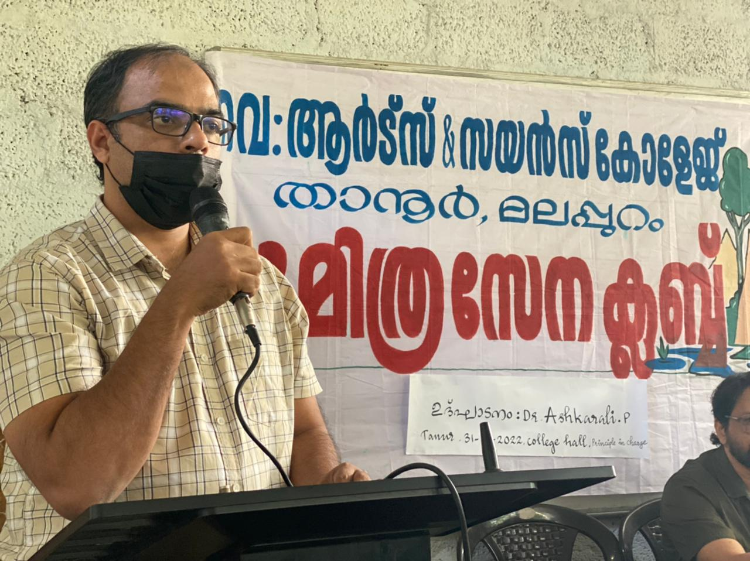
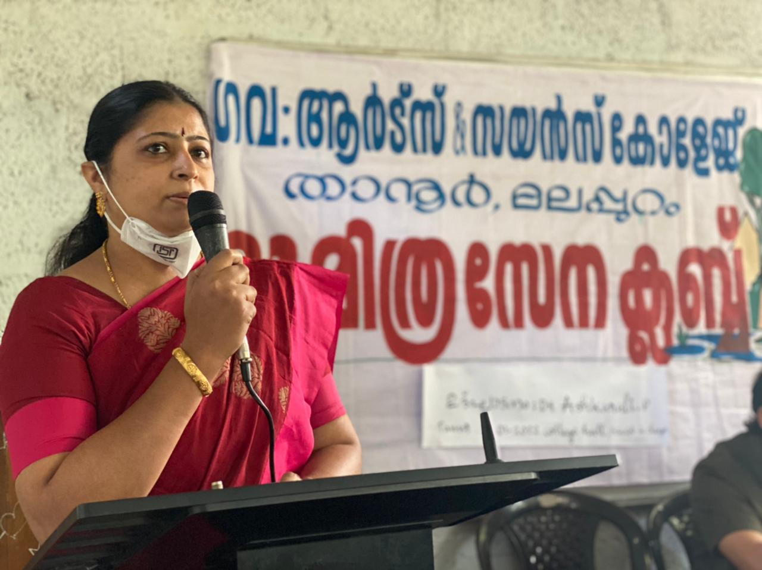
Club Inauguration
C.H.M.K.M GOVERNMENT ARTS AND SCIENCE COLLEGE,TANUR,K.PURAM.P.O,MALAPPURAM,KERALA,676307,PH:0494 2582800

Slide 7
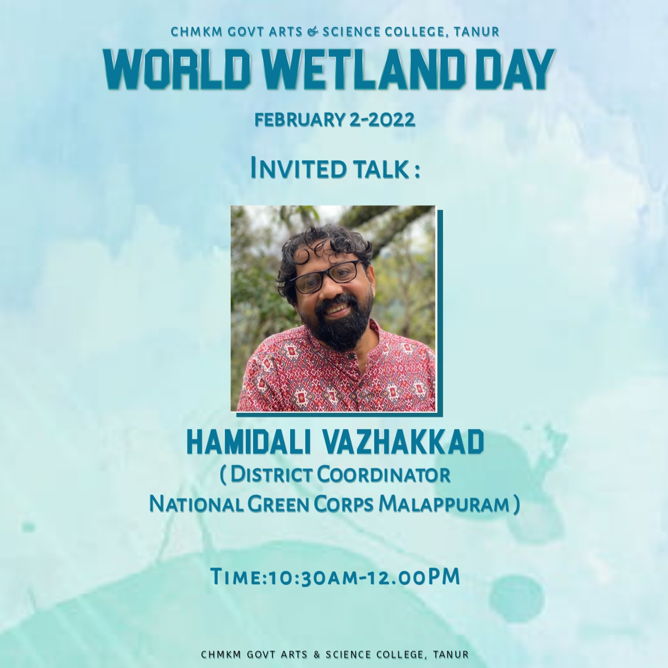
World Wetland Day
Picture
World Wetland day celebration was done on February 2nd 2022 at Pluto Hall at college Campus. An invited talk was done by Mr.Hamidali Vazhakkad district Coordinator National Green Corps, Malappuram.
C.H.M.K.M GOVERNMENT ARTS AND SCIENCE COLLEGE,TANUR,K.PURAM.P.O,MALAPPURAM,KERALA,676307,PH:0494 2582800

Slide 8
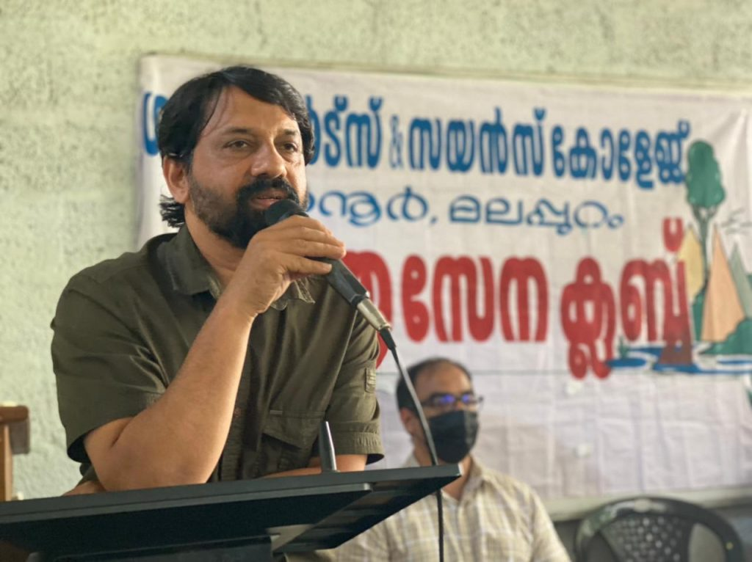
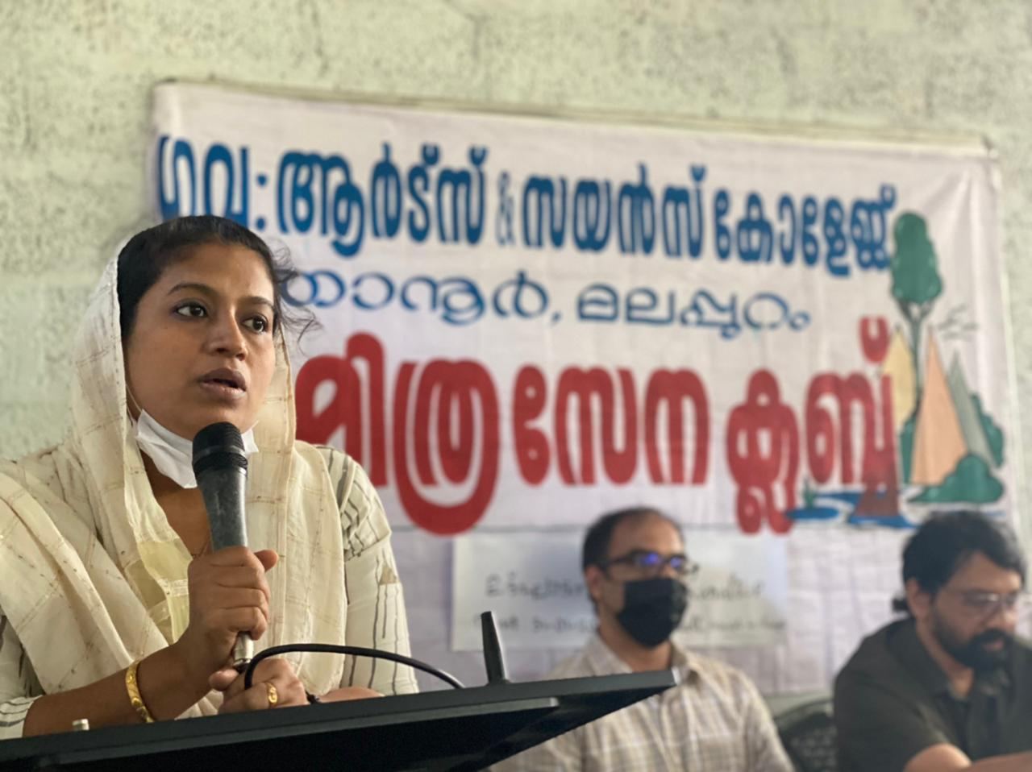
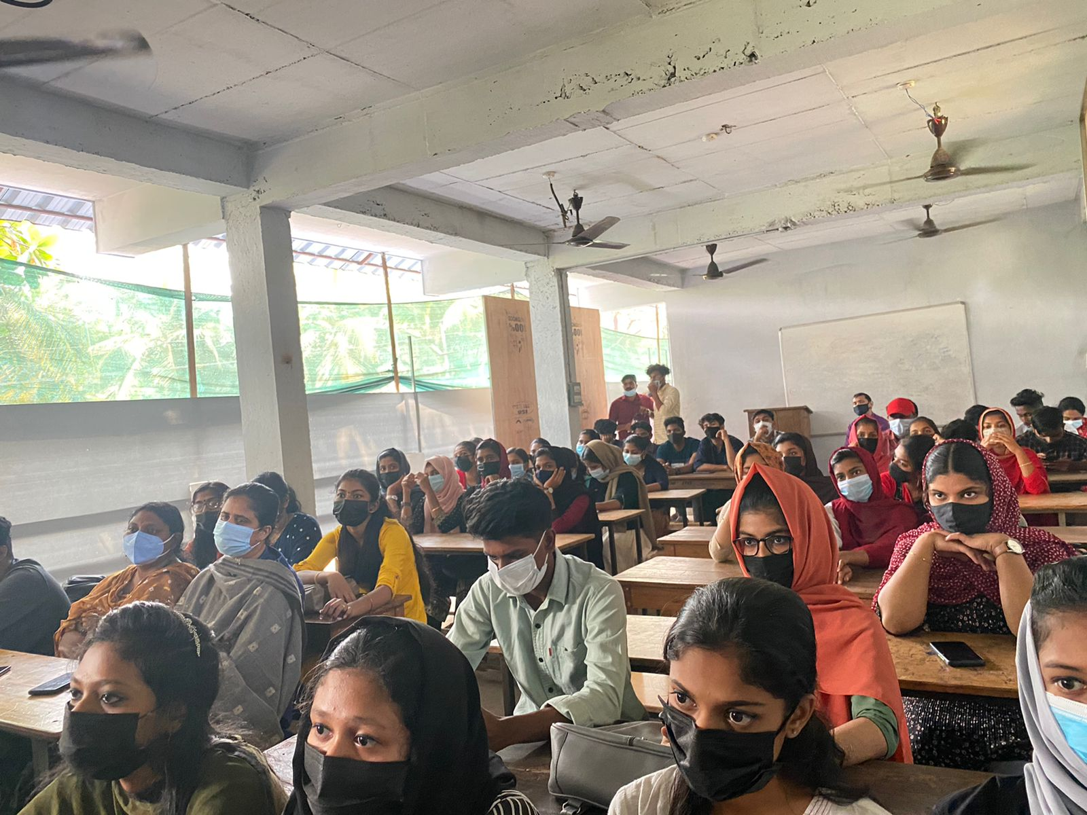
World Wetland day
C.H.M.K.M GOVERNMENT ARTS AND SCIENCE COLLEGE,TANUR,K.PURAM.P.O,MALAPPURAM,KERALA,676307,PH:0494 2582800

Slide 9
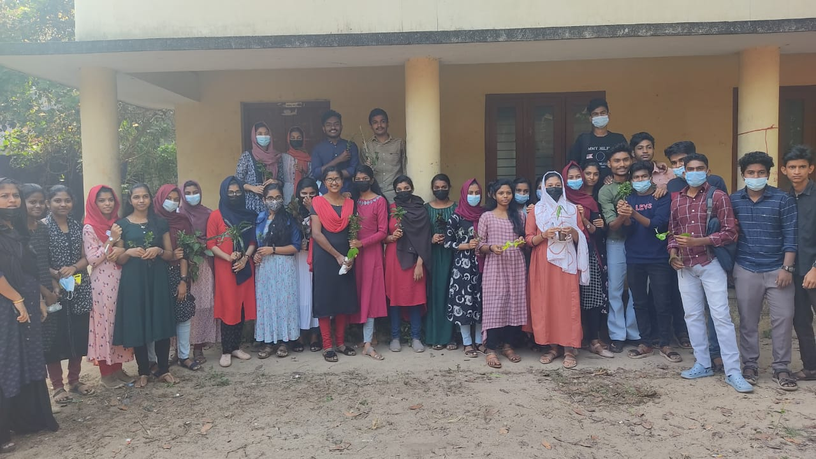
Gardening
Picture
Gardening was done by Club Members at College Campus on February 3rd 2022 .
C.H.M.K.M GOVERNMENT ARTS AND SCIENCE COLLEGE,TANUR,K.PURAM.P.O,MALAPPURAM,KERALA,676307,PH:0494 2582800

Slide 10
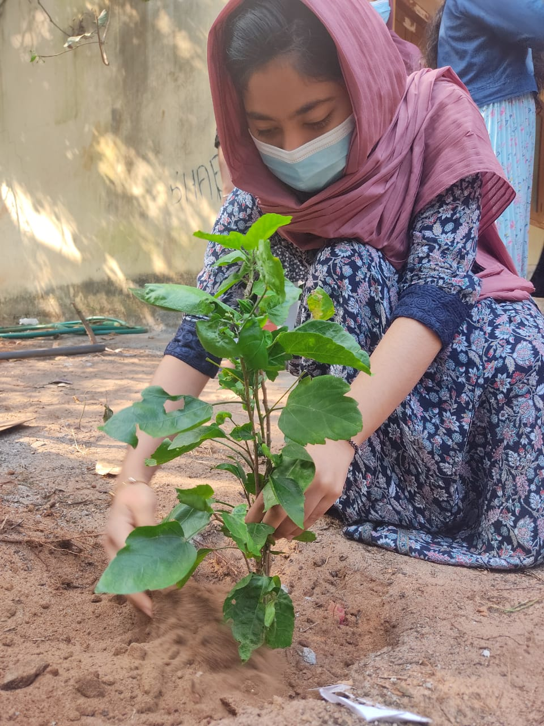
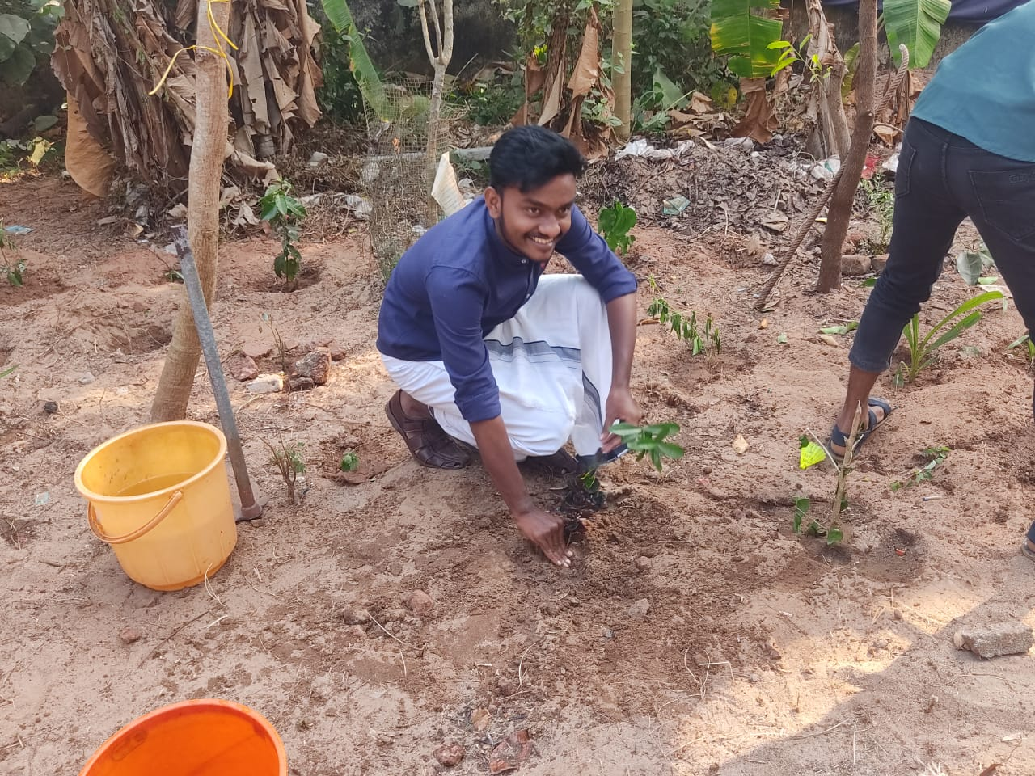
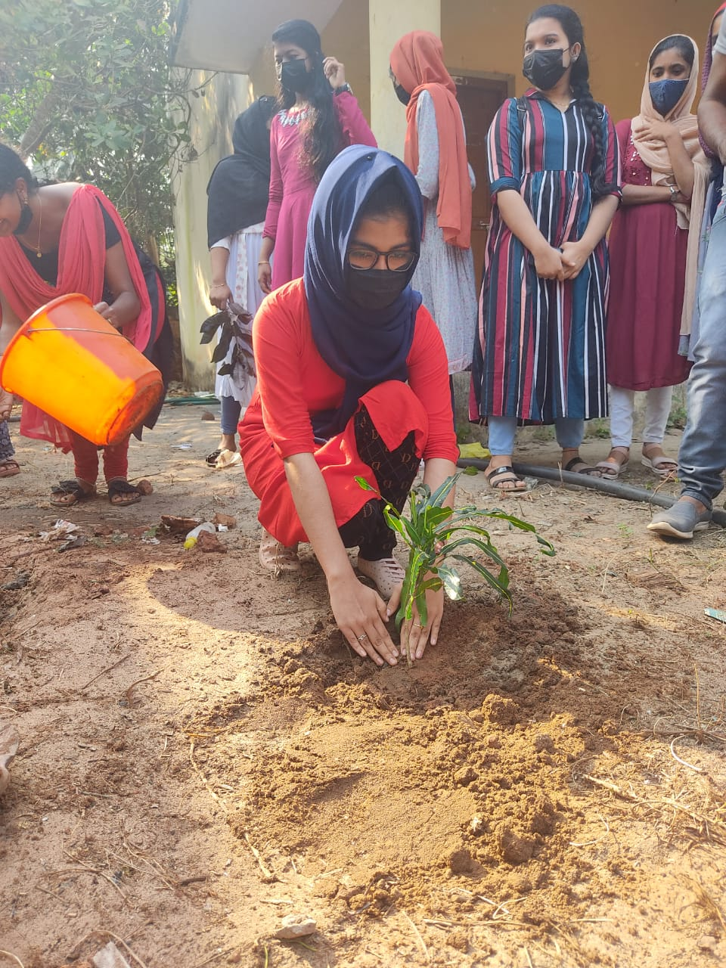
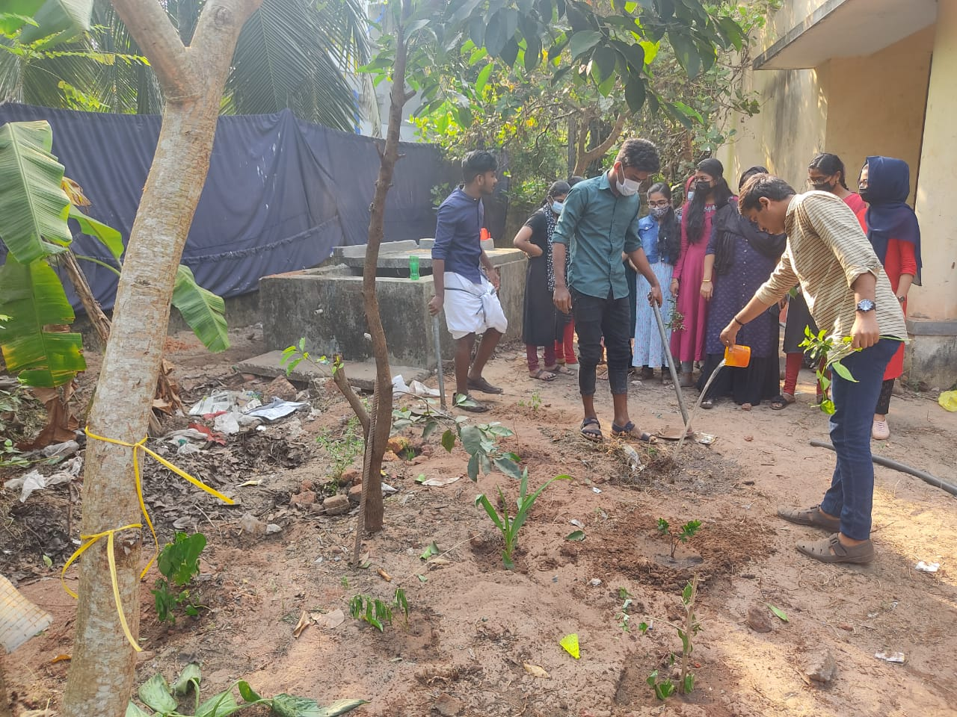
Gardening
C.H.M.K.M GOVERNMENT ARTS AND SCIENCE COLLEGE,TANUR,K.PURAM.P.O,MALAPPURAM,KERALA,676307,PH:0494 2582800

Slide 11
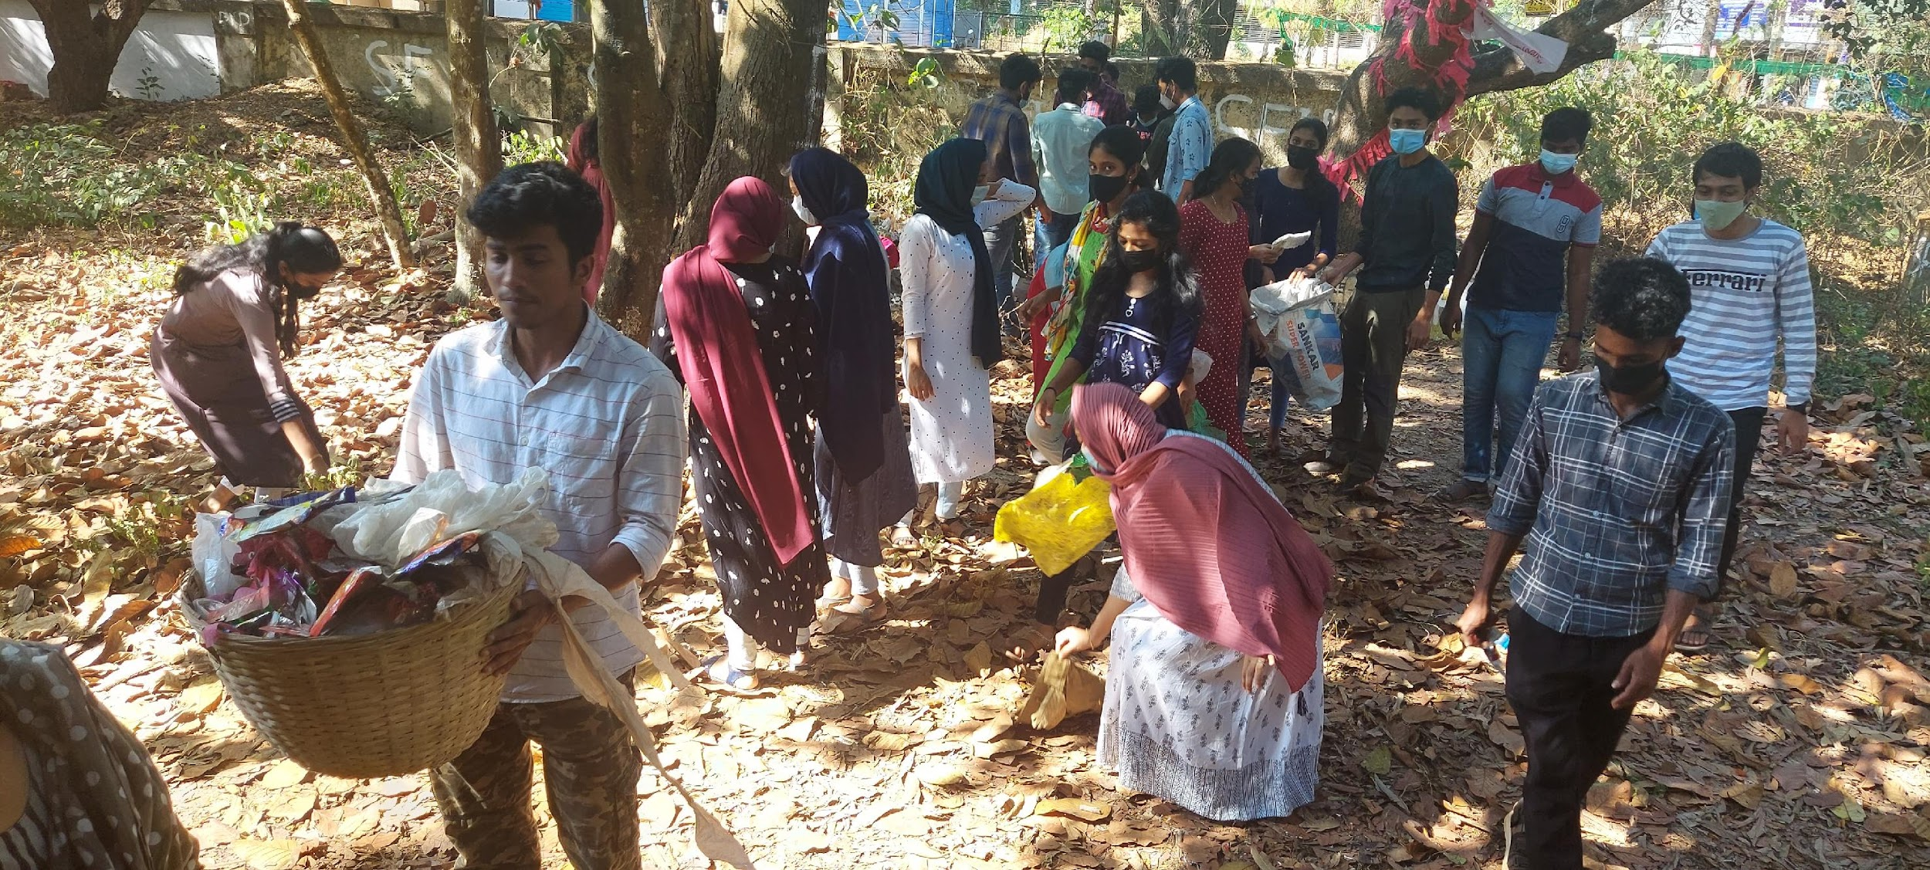
Clean Campus
C.H.M.K.M GOVERNMENT ARTS AND SCIENCE COLLEGE,TANUR,K.PURAM.P.O,MALAPPURAM,KERALA,676307,PH:0494 2582800

Slide 12
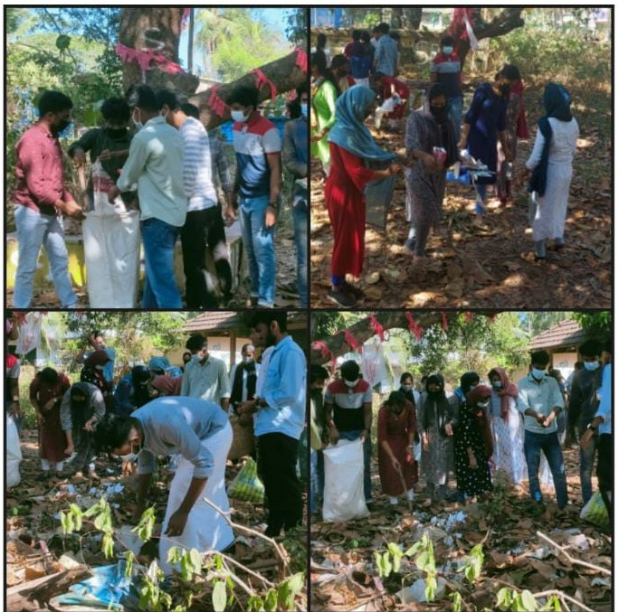
Clean Campus
Picture
Picture
Plastic free campus activity was done in collaboration with NSS Unit on 4th February 2022.
C.H.M.K.M GOVERNMENT ARTS AND SCIENCE COLLEGE,TANUR,K.PURAM.P.O,MALAPPURAM,KERALA,676307,PH:0494 2582800

Slide 13
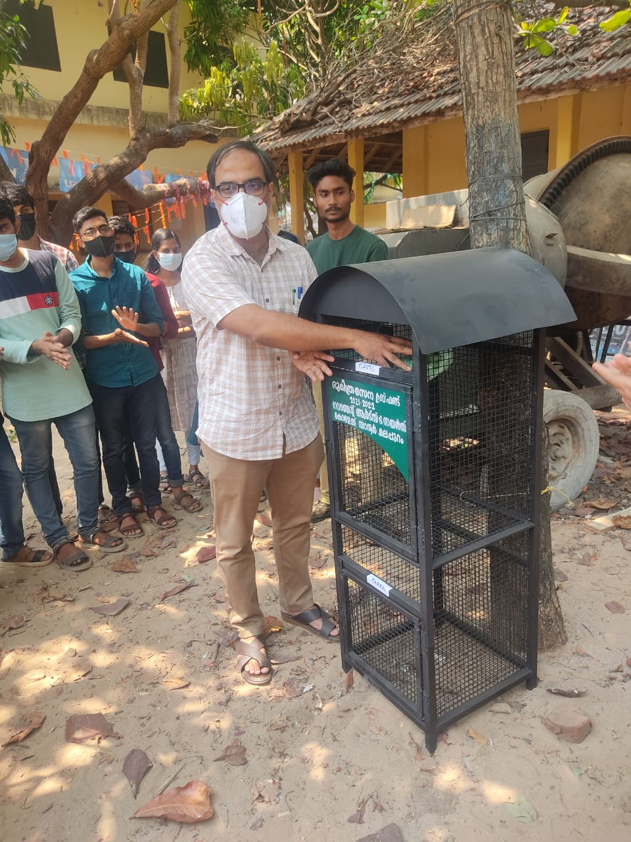
Waste Bin Inauguration
Picture
Picture
An iron waste bin was placed at the campus on 10th March-2022 inauguration was done by Dr.Ashkarali P Principal in charge.
C.H.M.K.M GOVERNMENT ARTS AND SCIENCE COLLEGE,TANUR,K.PURAM.P.O,MALAPPURAM,KERALA,676307,PH:0494 2582800

Slide 14

World Water Day Celebration
C.H.M.K.M GOVERNMENT ARTS AND SCIENCE COLLEGE,TANUR,K.PURAM.P.O,MALAPPURAM,KERALA,676307,PH:0494 2582800

Slide 15
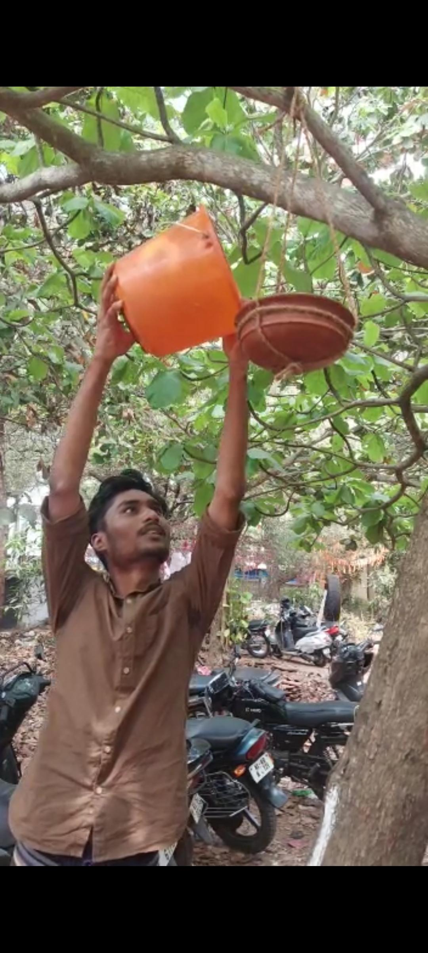
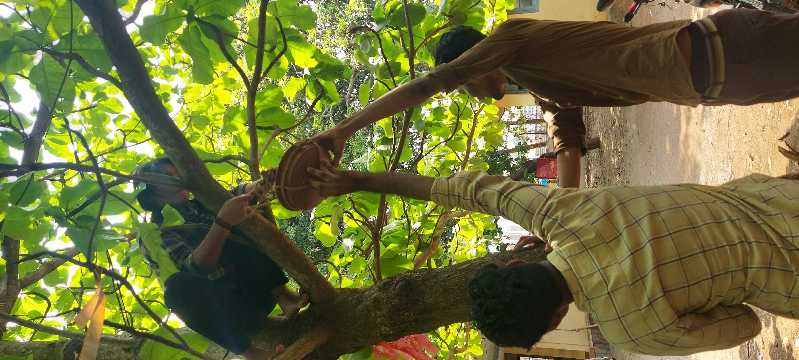
C.H.M.K.M GOVERNMENT ARTS AND SCIENCE COLLEGE,TANUR,K.PURAM.P.O,MALAPPURAM,KERALA,676307,PH:0494 2582800

Slide 16
Thank You!
C.H.M.K.M GOVERNMENT ARTS AND SCIENCE COLLEGE,TANUR,K.PURAM.P.O,MALAPPURAM,KERALA,676307,PH:0494 2582800

